Slide 1


The Rubric Revolution
Presentation at the
AES Conference, Sydney, Australia
September 1, 2011
Jane Davidson, Nan Wehipeihana & Kate McKegg
with Patricia Rogers (discussant)

Slide 2
Evaluative Rubrics:
The Basics
E. Jane Davidson, Ph.D.
Real Evaluation Ltd.
Auckland, Aotearoa New Zealand

Slide 3
Real evaluation is one step harder than descriptive research
Descriptive research asks “What’s So?”
  What are the outcomes of a particular intervention? (and why, for whom, etc)
Evaluation also asks:
  How good are the outcomes ...?
  ... and are those outcomes good enough?
Notes:
Penny Hawe was telling us earlier to celebrate and trumpet evaluation and what it is and does – get people to appreciate its value.
Part of that is being clear about what evaluation is – and how and where it adds value in a way that is quite different from descriptive research

Slide 4

Much so-called ‘evaluation’ skips this “how good is good” step
“You work it out”
Notes:
Why isn’t this really distinctive aspect of our work better understood? Because a lot of work called ‘evaluation’ skips the tricky bit and throws the task back to the client.
The value-free doctrine is still alive and well in the social sciences, even among researchers who take on work in evaluation.

Slide 5

Others do it with smoke & mirrors ...
“I looked upon it
and saw that
it was good”
Notes:
And then there are other areas where people conduct evaluations or reviews and seem to use divine judgement to get to their conclusions – this just fuels the argument that evaluation is all “just subjective”

Slide 6





Rubrics are an attempt to be systematic and transparent about it
Notes:
Shocking concept, yes.

Slide 7
What makes evaluation eVALUation?
What’s So?
Descriptive Facts
(qualitative, quantitative & mixed method evidence)
So What?
Evaluative
conclusions
(saying something explicit about
quality, value)
Definitions of
“quality”
& “value”
(also facts,
evidence-based
e.g. Needs,
potential,
aspirations)
+
→

Slide 8
What are evaluative rubrics?
Interpretation guides for evidence
(qual, quant, mixed; considered as a set)
“Ladders of change”
Definitions of “how good is good” and
“how good is good enough”
“Evidence pictures/scenarios” –
which one is the “best fit” with the evidence we have?
Notes:
Languaging matters – Nan and Kate will talk about this too

Slide 9
Rubrics may be very criterion-specific, e.g. Parent & whānau engagement in education
Rating | Description
Highly effective | Parents/whānau are extremely well-informed, confident and highly engaged in their children’s education in ways that maximise the children’s potential. Parent and whānau knowledge and perspectives are well respected, highly valued and fully integrated in ways that benefit the children’s education. Māori content and language are clearly evident and infused in ways that are appropriate for local whānau.
Minimally effective | Levels of parent/whānau/caregiver engagement are just sufficient to support children’s education, although there is significant room for improvement The school demonstrates understanding of Māori, Pasifika and other cultures, including the concepts of whānau, co-parenting and other family structures.
Poor or Detrimental | Any one or more of the following: Levels of whānau engagement are extremely low or are deteriorating – to an extent that adversely impacts children’s education Whānau report being talked “at” or down to, made to feel unwelcome or stupid, or that their perspectives are disrespected or sidelined Information is either withheld or presented in ways that prevent meaningful whānau involvement
Source: MOE projects (various)
Notes:
Hybrid from 3 pieces of work with the Ministry of Education:
Literacy Exploratory Study (an evaluative inquiry process & reflection tool to help schools better meet the needs of struggling readers and writers)
The Measurable Gains Framework (a macro-level approach to evaluating MOE’s Ka Hikitia strategy aimed at “Māori enjoying education success as Māori”)
Evaluation of the Specialist Education Itinerant Teaching Service (Group Special Education, 2008)
Note that the original versions had six levels; this is an abbreviated version just to illustrate the concept.

Slide 10
Rubrics can also be generic, to be applied across a range of questions/criteria
Performance Rating | Performance Descriptors for Answering Key Evaluation Questions
Excellent | Performance is clearly very strong or exemplary in relation to the question. Any gaps or weaknesses are not significant and are managed effectively.
Good | Performance is generally strong in relation to the question. No significant gaps or weaknesses, and less significant gaps or weaknesses are mostly managed effectively.
Adequate | Performance is inconsistent in relation to the question. Some gaps or weaknesses. Meets minimum expectations/ requirements as far as can be determined.
Poor | Performance is unacceptably weak in relation to the question. Does not meet minimum expectations/requirements.
Insufficient evidence | Evidence unavailable or of insufficient quality to determine performance.
Source: NZQA’s External Evaluation & Review framework
Notes:
This example was taken from NZQA’s External Evaluation and Review (EER) methodology.
Completely generic rubric that is applied to answers to process and outcome evaluation questions.

Slide 11
Rubrics demand systematic use of evaluative inference to make ratings
e.g. when rating “Good” |  | you need to show …
Key points from performance descriptors | Performance is generally strong in relation to the question. | Specifically, what evidence led you to believe performance was “generally strong” – as opposed to “clearly very strong or exemplary” (excellent) or “inconsistent” (adequate)? Include the most important examples of BOTH positive and negative evidence.
 | No significant gaps or weaknesses, | What were the gaps or weaknesses, and why should they be considered “not significant”? Based on what?
 | and less significant gaps or weaknesses are mostly managed effectively. | What, specifically, is the tertiary education organisation doing to manage gaps and weaknesses, and why do you consider this “effective management” in most or all instances?
Notes:
So, you can’t just say “ohhh, I’ll give it a very good” – you actually have to produce some very specific evidence to support the conclusion.
Many people accuse evaluation (especially real evaluation, i.e. truly evaluative evaluation) of being “just subjective”.
Here, the “just personal preference/opinion” aspect of subjectivity is minimised while still maintaining the benefits of the “good professional judgement” type of subjectivity – the one that (if done well) can fathom and weigh the nuances.
In other words, you still have to use your head (you can’t opt out and just go for stats or stories as though they speak for themselves), but it can’t be “all in your head” either - you have to make transparent how evaluative conclusions are drawn and based on what values (e.g. How do you judge a weakness to be ‘significant’ or not – based on what?).

Slide 12
How do you create rubrics?
Get the right people in the room!
Clearly identify your evaluation question or criterion
Brainstorm what distinguishes ‘highly effective’ from ‘ineffective’ (or worse) performance
Draw boundaries around what’s in and out
Facilitate the rubric writing process
Debate; recalibrate; field test; hone

Slide 13
Why rubrics?
Why not just indicators?
Indicators
Criterion
Outcome
domain
Indicators
True Criteria
Easy to measure
Precise
Narrow
Manipulable
Harder to measure
Approximate
Broad-brush
Unmanipulable

Slide 14
The three kinds of ‘subjectivity’
Arbitrary, idiosyncratic, unreliable, and/or highly personal (i.e., based on personal preferences and/or cultural biases)
Assessment or interpretation by a person, rather than a machine or measurement device, of something external to that person (e.g., expert judgment of others’ skills or performance)
About a person’s inner life or experiences (e.g., headaches, fears, beliefs, emotions, stress levels, aspirations), all absolutely real but not usually independently verifiable
Plus the red herring: Subjective vs. objective measures

Slide 15
Using rubrics to give voice to indigenous values
Nan Wehipeihana
Research Evaluation Consultancy
Aotearoa New Zealand

Slide 16
Development of rubrics in indigenous contexts
So language matters
How we talk about rubrics, about success, about progression
  Explicit way of defining “quality” and “value” for ourselves and for others.
  Compared to
  To identify what’s important to us, what’s important to others, what matters and come to a shared understanding…

Slide 17
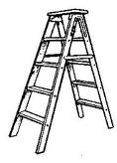


Cultural metaphors
Poutama – Māori cultural symbol, stairway, progression, movement up and down
Contemporary context – health providers talk about a ladder

Slide 18
Development of rubrics in indigenous contexts
So they get the concept (poutama) but the language of rubrics (of evaluation) can be hard to get
An explicit way of defining “quality” and “value” for ourselves and for others:
  Evaluative criteria (what aspects are important?)
  Merit criteria (how good is “good”?)
  Making a judgment, using these criteria, about how good, or excellent (or poor) something is (merit determination)

Slide 19
Development of rubrics in indigenous contexts
The “success” language can be problematic
  Nga moemoea – dreams, Nga wawata – aspirations, desires
  Not just the language some concerns about ‘labelling’
  Use different terms for the performance levels in the rubric
Text dense matrix – is a turn off for some
  Alternative presentation formats
  When they get it conceptually – the language makes sense

Slide 20
Topic
Giving voice to indigenous values
I learned from my Grandparents…
I learned from my Parents…
I would like to teach my mokopuna (grandchildren)…
My tamariki (children) learned from me…

Slide 21
Example – an ‘as Māori’ developmental journey with five dimensions emerging
By Māori | Refers to the extent of control (rangatiratanga) by Māori in the governance, management and delivery of an initiative
For Māori | Emphasises the importance of family, sub-tribe, tribe (whānau, hapu, iwi), and other Māori collectives bought together for Māori purposes
With te reo me ona tikanga | Points to the importance of Māori language and customs (te reo me ona tikanga) as central to the survival and affirmation of what it means to live ‘as Māori’
In/on places of cultural significance to Māori | From ancestral places such as meeting houses, rivers, mountains (marae, awa, maunga), to more contemporary places founded on Māori principles such as immersion Māori kindergartens and schools (kōhanga reo, kura) etc.
Through | Those activities that can be distinguished as traditionally Māori (e.g., nga taonga taakaro, or ki o rahi)

Slide 22
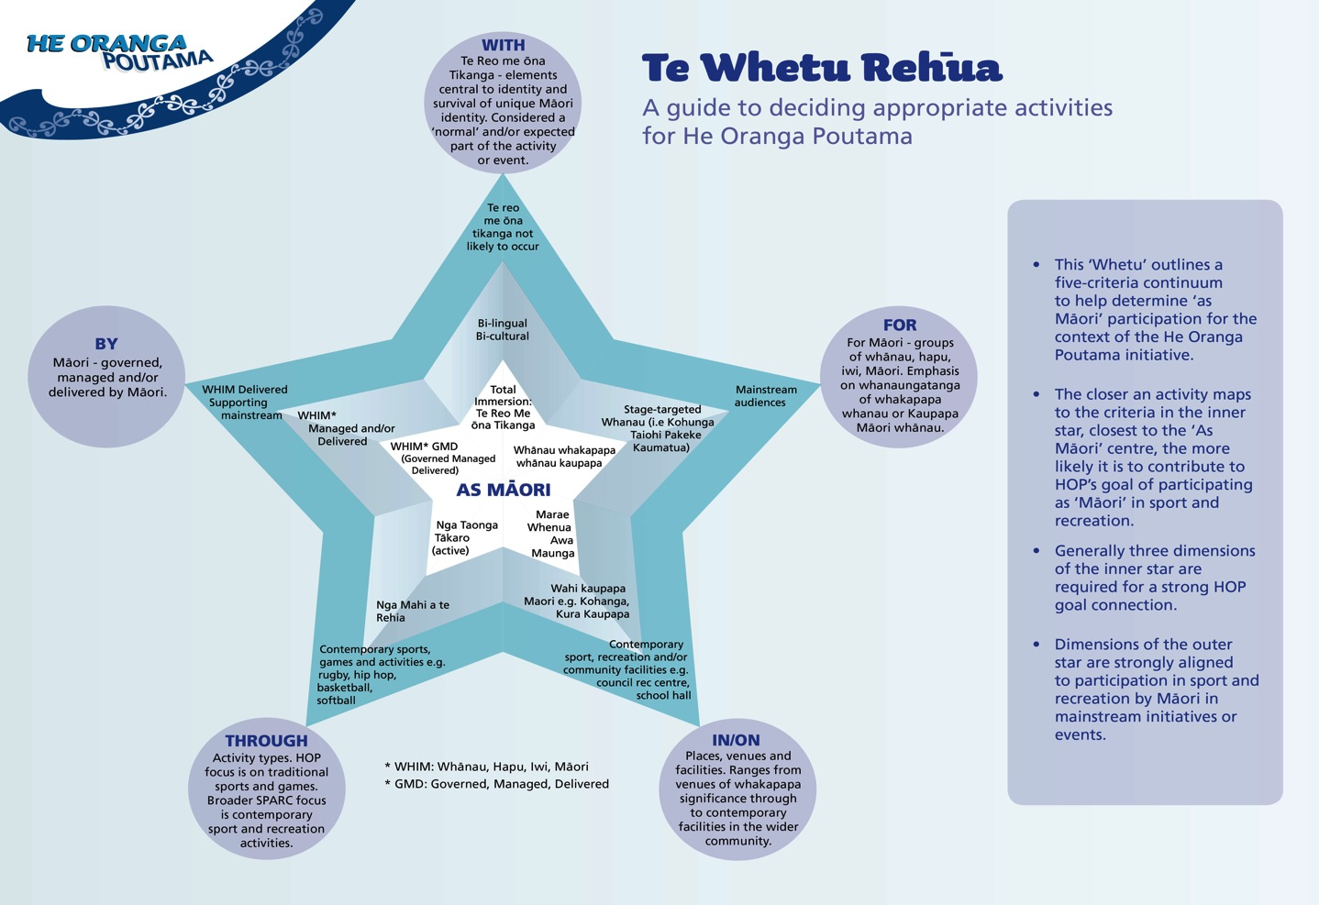

Slide 23
Knowing about rubrics is one thing … tips, tricks and traps
Kate McKegg
The Knowledge Institute
Aotearoa New Zealand

Slide 24
A mental health setting
Provider is recovery focused
Has a strong commitment to peer led and peer informed services
Not satisfied with many of the more ‘objective’ outcome measures being used in mental health, i.e., bed nights in acute care, readmission rates, etc.
Wanted a framework that ‘valued’ what consumers saw as ‘recovery’ and ‘wellness’

Slide 25
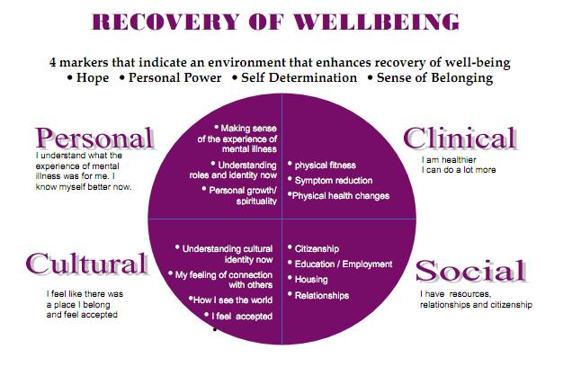
Wellink’s outcome framework is recovery focused

Slide 26
A suite of evaluative criteria developed
A Recovery Matrix
Personal |  | Clinical
Hope for the future |  | Daily living skills
Quality of life |  | Mental Health
Spirituality / Personal Beliefs |  | Physical Health
Cultural |  | Social
Culture |  | Housing and accommodation
Relationships (whānau) |  | Money and finances
Autonomy |  | Education, training and work (paid and unpaid
Notes:
driven by the literature
informed by practice
and fine-tuned by a wide range of stakeholders

Slide 27
Individual outcome rubric:
Housing and accommodation
Crisis | At Risk | Stable / supported | Self-sufficient | Thriving
I am homeless, or about to be evicted: my personal safety is at risk and I am unsafe to remain at home. I am unable to continue living either on my own or with the people I live with. The situation is intolerable | I am at risk of eviction, either because of my actions or because I can not afford the rent. I feel unsafe in my home. My house is in a state of disrepair. I lack some furnishings which I would like. I would like to change my living arrangements. | My housing Is okay – it is warm, dry and affordable. I am safe in my home and have essential furnishings. Some of the time I am ok with who I live with but would like things to be different in the future | I am happy with my housing. My home is comfortable, safe and affordable and furnished to my liking. I am happy with my living arrangements – I like living by myself, with family or housemates. | I am settled and happy in the house of my choice, at this time. It is comfortable, safe and affordable and furnished to my liking. I really enjoy living by myself, with family or with housemates.

Slide 28
A graph of change – used for understanding the recovery journey
“Expanded our understanding of what personal planning is all about”

Slide 29
A proram level example – acute peer support residential service
Characteristics of peer support evaluative criteria were
  driven by the literature
  informed by practice
  and fine-tuned by stakeholders
The four key evaluative criteria developed were:
  There is effective and appropriate client (guest) engagement
  Peer support workers are able to provide a climate and context which assists guest recovery
  Peer support workers have the skills and attitudes to assist guest recovery
  There is effective and appropriate management of peer support teamwork

Slide 30
Then we determined levels of performance
Rating | Performance Descriptors for Answering KEQ
Excellent (Always) | Clear example of exemplary performance or best practice in this domain: no weaknesses
Very good (Almost always) | Very good to excellent performance on virtually all aspects; strong overall but not exemplary; no weaknesses of any real consequence
Good (Mostly, with some exceptions) | Reasonably good performance overall; might have a few slight weaknesses, but nothing serious
Adequate: (Sometimes, with quite a few exceptions) | Fair performance, some serious, but non fatal weaknesses on a few aspects
Poor: Never (Or occasionally with clear weakness evident) | Clear evidence of unsatisfactory functioning; serious weaknesses across the board on crucial aspects
Insufficient evidence | Evidence unavailable or of insufficient quality to determine performance
Source: Adapted from Davidson, E.J. (2010) ‘Actionable self-assessment and evaluation for the real world.’
Presented at NZQA Self-Assessment for Quality Otago Polytechnic, Dunedin, NZ, December 2, 2010

Slide 31
Rubrics allow for transparent synthesis
… For a combination of both
quantitative and qualitative data

Slide 32
Reporting: can summarise evaluative criteria level overall

Slide 33
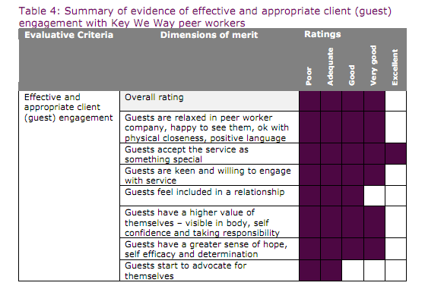
Or can summarise at a lower level
Source: McKegg, K., & Oakden, J. (2009). Characteristics of good peer support. Wellington: Wellink Trust. (p.15)

Slide 34
Overall evaluative conclusion
“…The service shows great potential to affect significant and lasting change in guests for the following reasons:
Generally strong on peer skills, relationship building and creating a climate of trust and mutual support focused on recovery
Some management and supervision weaknesses although these were being actively addressed by the organisation”

Slide 35

Diabetes prevention
Complex, intractable health issue, at population level
Among Māori in New Zealand, the profile of disease is much worse than for non-Māori
Māori health providers – looking for innovative ways of tackling the issue

Slide 36
A new model of care
The new programme model of care is intended to created a paradigm shift, transforming the more traditional 15 minute general-practice approach to care, to a care pathway and support programme involving a team working with whānau (families).

Slide 37
7 Outcome Domains – essential
for wellness
Self Managing
Living Healthy Lifestyles
Participating Fully in Society
Economically Secure
Confidently Participating in Te Ao Maori
Cohesive, Resilient and Nurturing
Blood Pressure
Clinically Secure
HBa1c
Weight
Cholesterol
CV risk
Waist measurement

Slide 38
Each outcome domain has 5 levels
Levels | Evaluative criteria
 | Living healthy lifestyles | Participating fully in society
Self Reliance / reaching full potential | Increased participation in sport and recreational physical activity Improved choices made about consumption of healthy food and other substances Strengthened ability to access support when needed Improved whānau connectedness Greater ability to maintain safety (emotional, mental, spiritual and physical) | Increased recognition of whānau assets and strengths Improved educational opportunities and success among whānau Strengthened ability to connect and engage in and with community and whānau activities Greater abilities and confidence to advocate for whānau needs and aspirations
Wellbeing
Recognition and Belief
Awakening / awareness
Unwakened / untapped potential

Slide 39
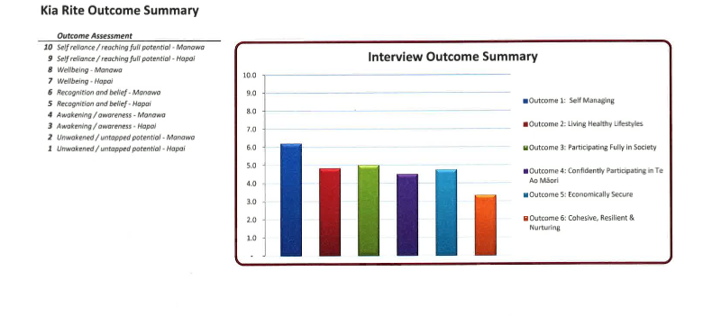
Whānau are self assessing

Slide 40
Key tips, tricks and traps when developing rubrics
Context really matters
Getting the right people in the room is important
Language is important for acceptance and use - Rubrics are sexy. But ‘rubrics’ is NOT a sexy word!!
Directionality isn’t a trivial issue
Don’t overcomplicate it

Slide 41
The value of rubrics
Versatile – they work well for:
  participatory or ‘independent’ evaluation
  “fairly quick and fairly clean” or in-depth analysis
  qualitative, quantitative – but especially good for mixed methods
  needs assessment (baseline) and outcomes
  overviews and drilldown
Build shared understanding of what constitutes ‘effectiveness’ – provided you get the languaging right!

Slide 42
The value of rubrics
Serious about values - perfect for ensuring community, cultural & organizational values/aspirations incorporated
Identify multiple levels of performance and progress, not just one vaguely ‘acceptable’ level
Cover the vast majority of the process or outcome domain => largely unmanipulable

Slide 43

References and resources
Davidson, E. J. (2004). Evaluation
methodology basics: The nuts and
bolts of sound evaluation. Thousand
Oaks, CA: Sage.
Measurable Gains Framework rubrics
downloadable from http://tiny.cc/kahikitia
Self-review tool for schools: Focus on students achieving below curriculum expectations in literacy http://tiny.cc/literacytool
Genuine Evaluation blog (Jane Davidson &
Patricia Rogers) http://GenuineEvaluation.com
Jane’s website: http://RealEvaluation.com

